Slide 1




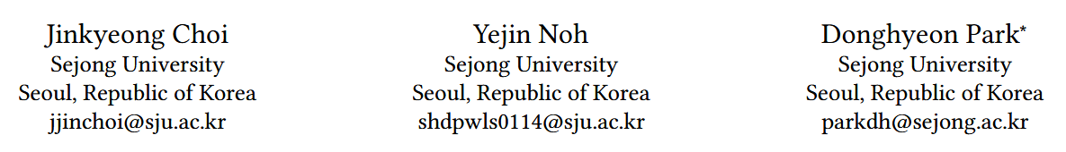





ATAI
Advanced Technique of Artificial Intelligence
ATAI
ChongqingUniversity _{AdvancedTechniqueof}
of Technology Artificial Intelligence
Chongqing University of
Technology
Chongqing University ^{ATAI}
_{of Technology} Advanced Techniqueof
Artificial Intelligence
Chongqing University of Technology
Chongqing University of Technology
SimDiffRec : Diffusion based on semantic similarity guidance for comparison sequence recommendation
Code: https://github.com/zingyon/SimDiffRec
—WSDM 2026
Reported by Cong Sheng
1

Slide 2
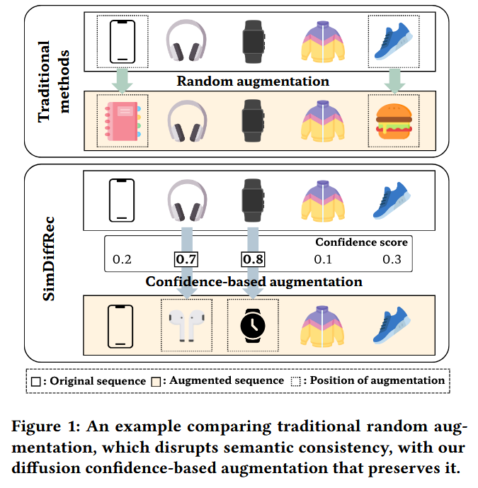
ATAI
Advanced Technique of Artificial Intelligence
ATAI
ChongqingUniversity _{AdvancedTechniqueof}
of Technology Artificial Intelligence
Chongqing University of
Technology
Chongqing University ^{ATAI}
_{of Technology} Advanced Techniqueof
Artificial Intelligence
Chongqing University of Technology
Chongqing University of Technology
Motivation
1) Random operations often fail to preserve the underlying semantic structure and contextual consistency of the user’s behavioral patterns.
2) Although diffusion models typically use random noise, existing methods that use diffusion for data augmentation have the limitation that the generated samples do not sufficiently maintain semantic consistency or contextual alignment.

Slide 3
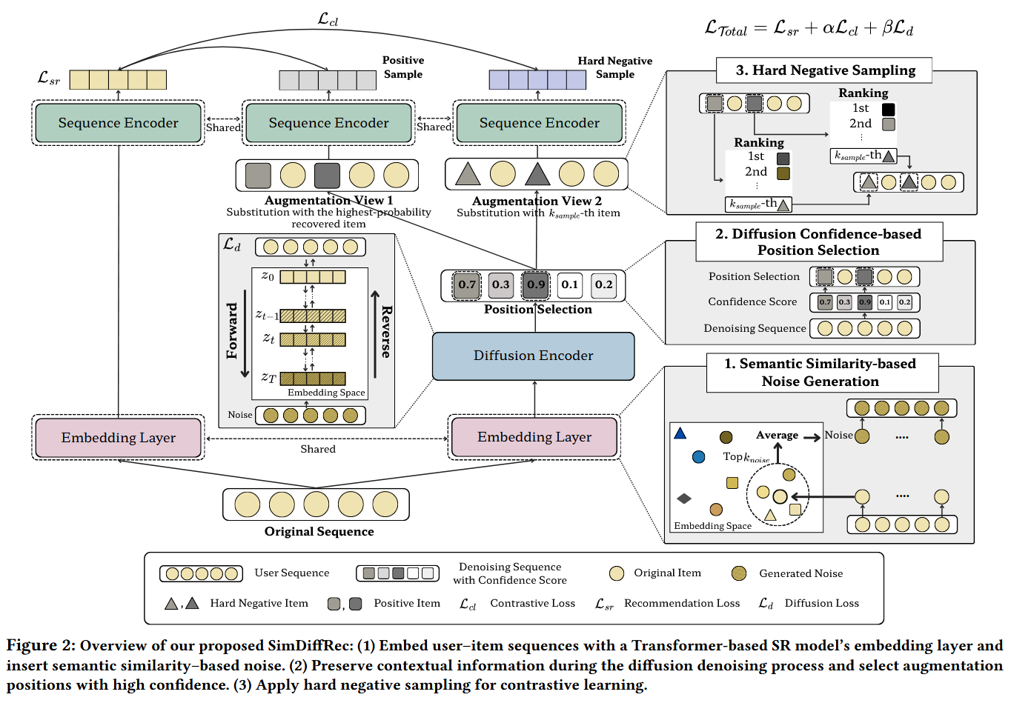
ATAI
Advanced Technique of Artificial Intelligence
ATAI
ChongqingUniversity _{AdvancedTechniqueof}
of Technology Artificial Intelligence
Chongqing University of
Technology
Chongqing University ^{ATAI}
_{of Technology} Advanced Techniqueof
Artificial Intelligence
Chongqing University of Technology
Chongqing University of Technology
Overview

Slide 4







ATAI
Advanced Technique of Artificial Intelligence
ATAI
ChongqingUniversity _{AdvancedTechniqueof}
of Technology Artificial Intelligence
Chongqing University of
Technology
Chongqing University ^{ATAI}
_{of Technology} Advanced Techniqueof
Artificial Intelligence
Chongqing University of Technology
Chongqing University of Technology
Method

Slide 5











ATAI
Advanced Technique of Artificial Intelligence
ATAI
ChongqingUniversity _{AdvancedTechniqueof}
of Technology Artificial Intelligence
Chongqing University of
Technology
Chongqing University ^{ATAI}
_{of Technology} Advanced Techniqueof
Artificial Intelligence
Chongqing University of Technology
Chongqing University of Technology
Method

Slide 6
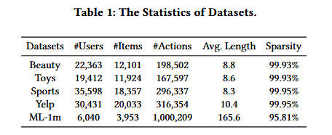
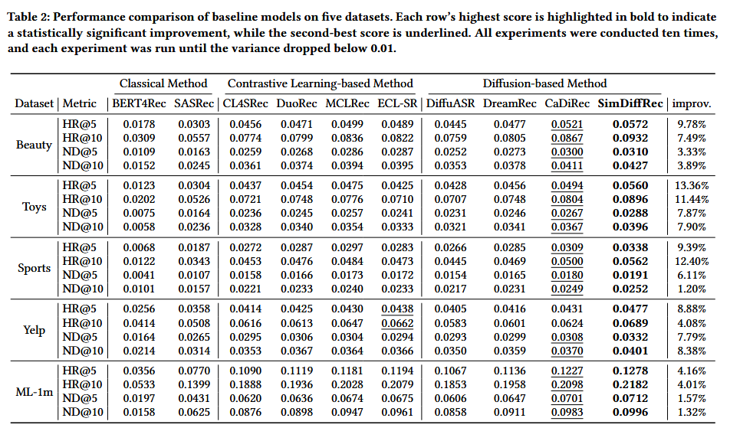
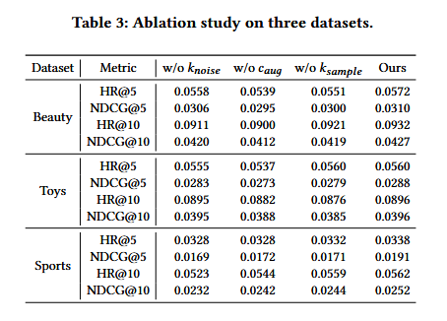
ATAI
Advanced Technique of Artificial Intelligence
ATAI
ChongqingUniversity _{AdvancedTechniqueof}
of Technology Artificial Intelligence
Chongqing University of
Technology
Chongqing University ^{ATAI}
_{of Technology} Advanced Techniqueof
Artificial Intelligence
Chongqing University of Technology
Chongqing University of Technology
Experiments

Slide 7
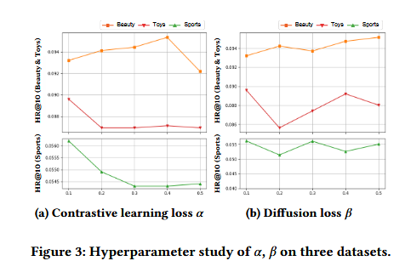
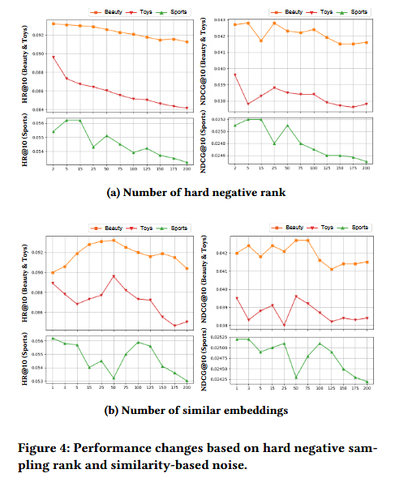
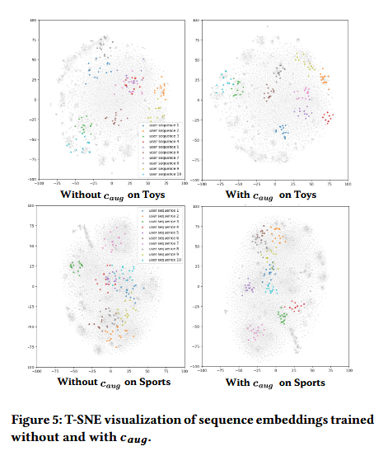
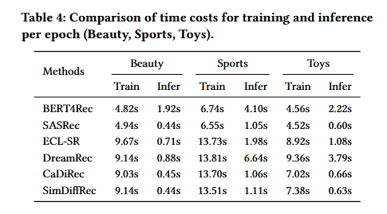
ATAI
Advanced Technique of Artificial Intelligence
ATAI
ChongqingUniversity _{AdvancedTechniqueof}
of Technology Artificial Intelligence
Chongqing University of
Technology
Chongqing University ^{ATAI}
_{of Technology} Advanced Techniqueof
Artificial Intelligence
Chongqing University of Technology
Chongqing University of Technology
Experiments

Slide 8


ATAI
Advanced Technique of Artificial Intelligence
ATAI
ChongqingUniversity _{AdvancedTechniqueof}
of Technology Artificial Intelligence
Chongqing University of
Technology
Chongqing University ^{ATAI}
_{of Technology} Advanced Techniqueof
Artificial Intelligence
Chongqing University of Technology
Chongqing University of Technology
Thanks!

